Slide 1

Draft-Mxene
Presented by:
Yang Bai
Date: 2023/5/XX

Slide 2
01
Introduction
02
Result & Discussion
2.1
Mo2C
Catalogue
2.2
Mo2Ti2C3
03
Conclusion

Slide 3
SEM & EDS Analysis for Mo2C
MAY
FEB

Slide 4
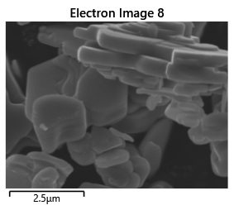
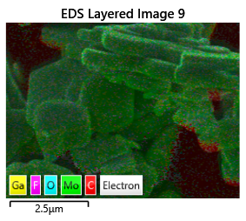
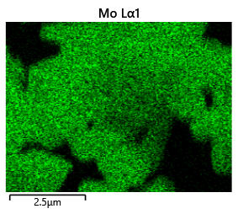
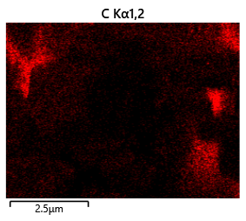
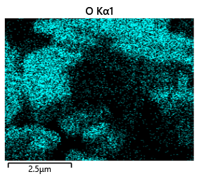
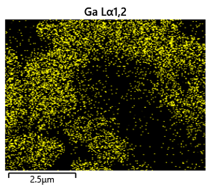
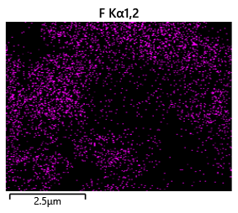
SEM & EDS Analysis for Mo2C

Slide 5
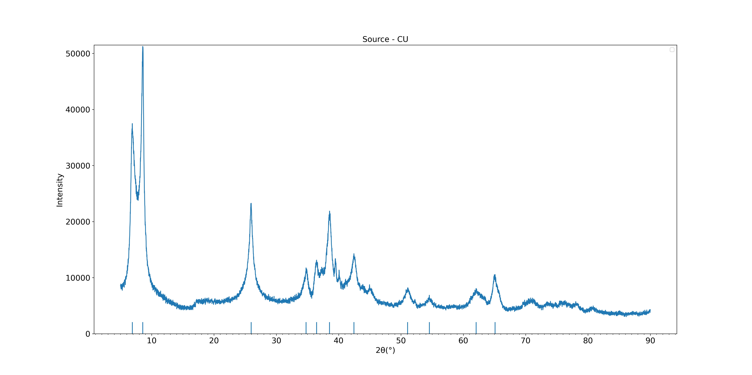
XRD Analysis for Mo2C
Top-down approach

Slide 6
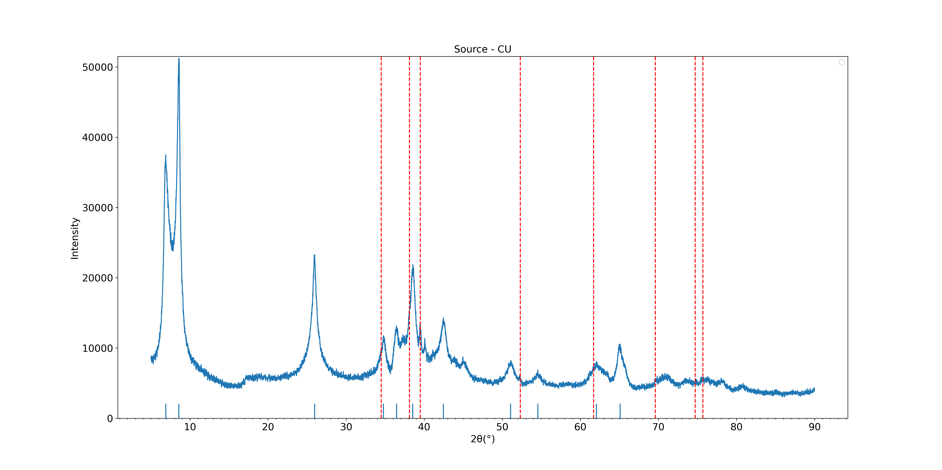
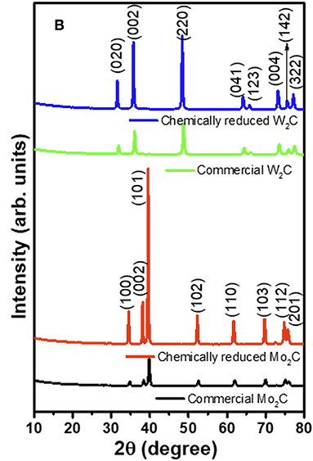
XRD Analysis for Mo2C
Top-down approach
*Reference[1]: https://doi.org/10.3389/fchem.2019.00716

Slide 7
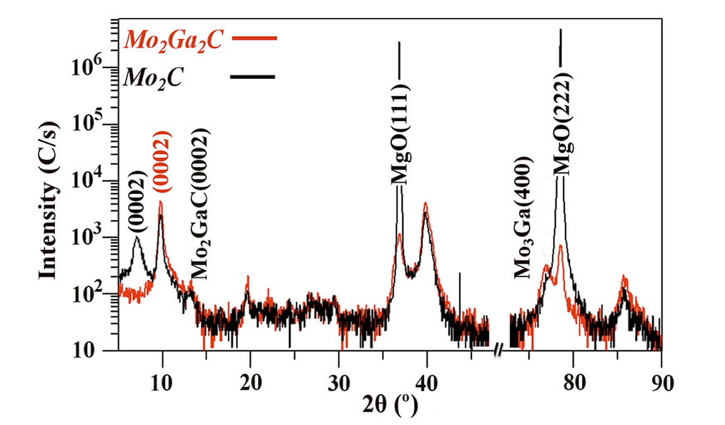
XRD Analysis for Mo2C
Top-down approach
*Reference[2]: http://dx.doi.org/10.1016/j.scriptamat.2015.07.003

Slide 8
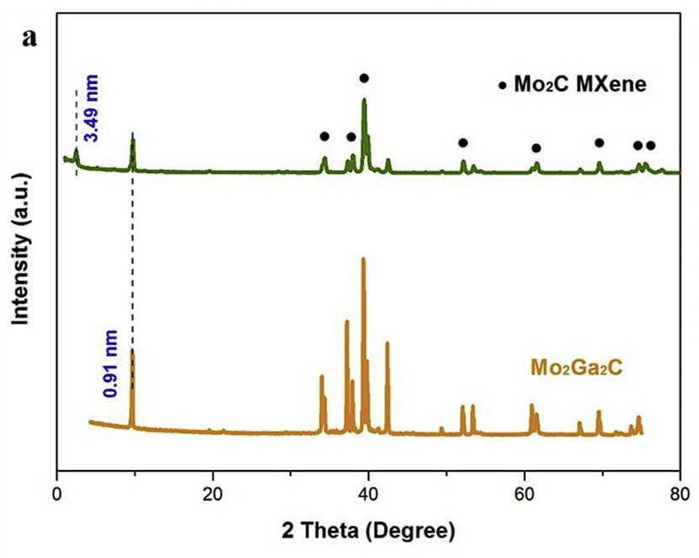
XRD Analysis for Mo2C
Top-down approach
*Reference[3]: https://doi.org/10.1016/j.susmat.2020.e00156

Slide 9
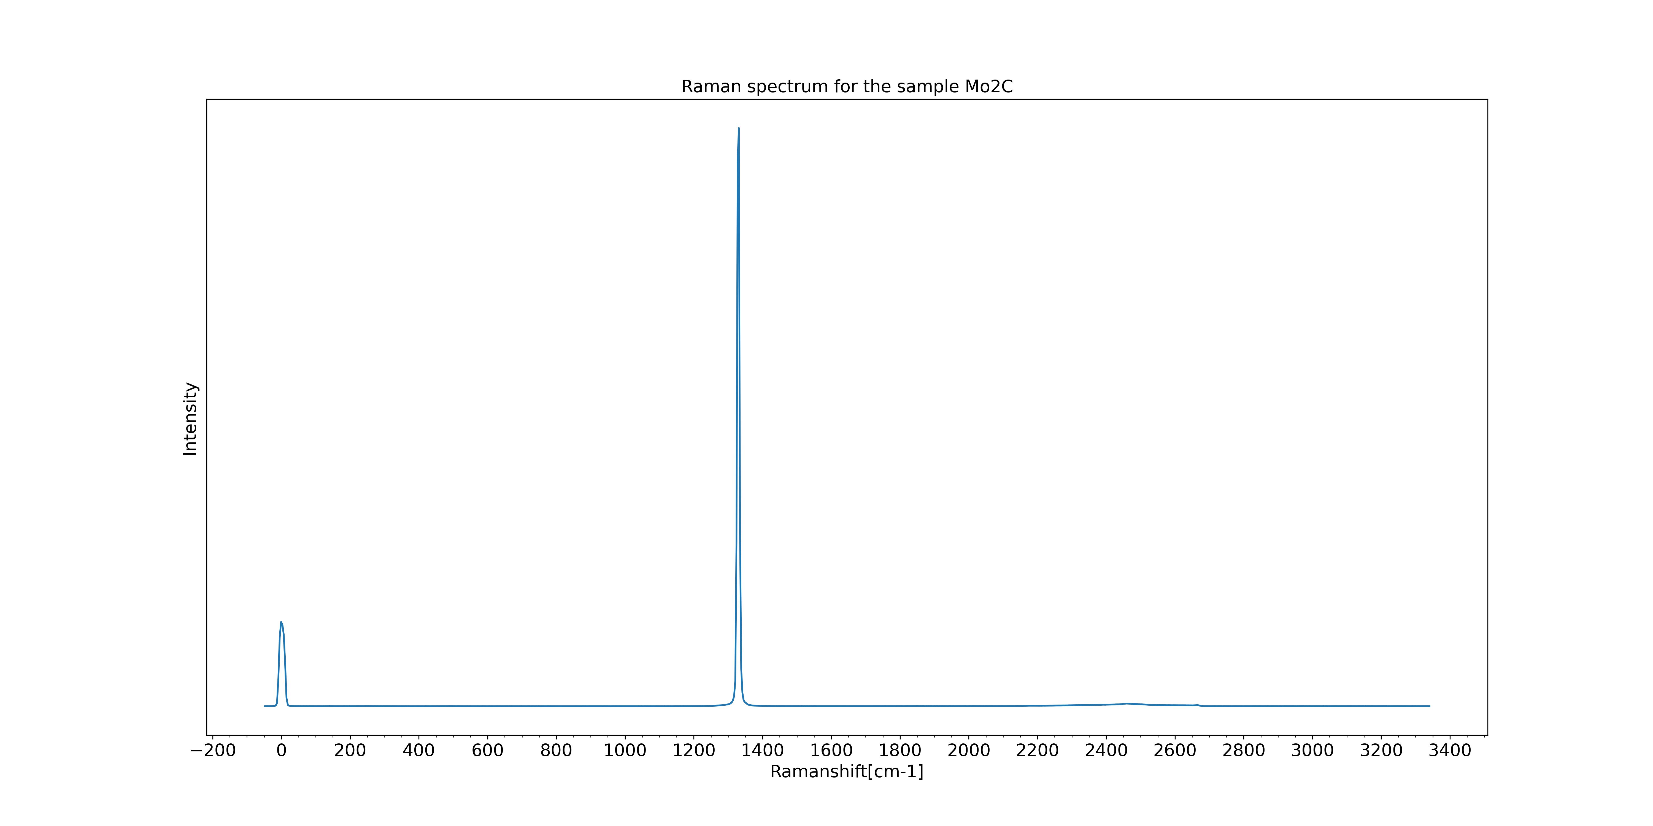
Raman Analysis for Mo2C
Diamond
Top-down approach
Area we focus on
Laser

Slide 10
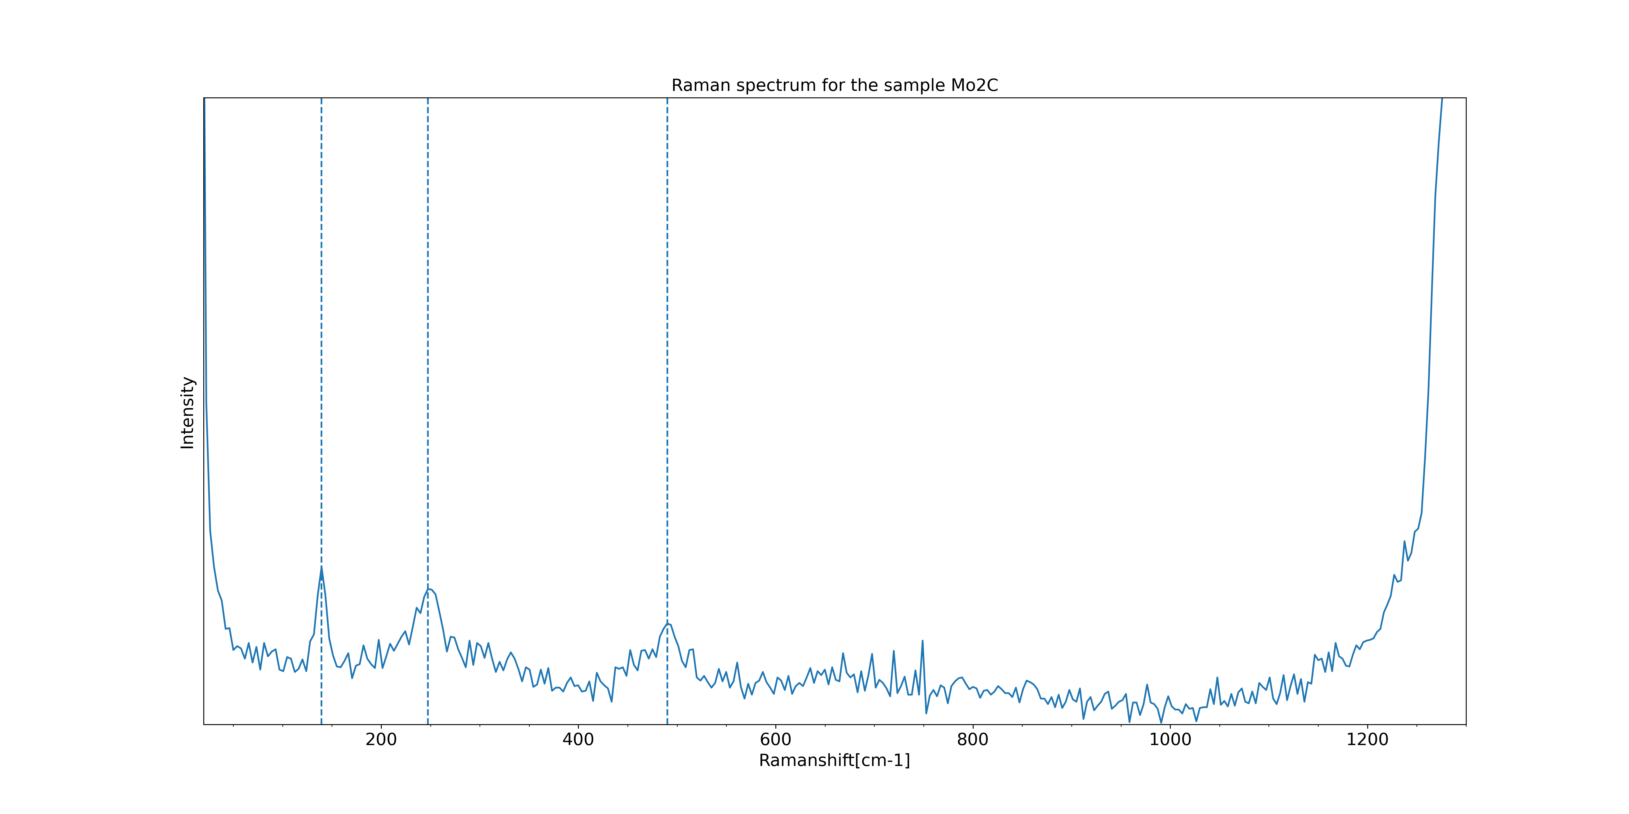
Raman Analysis for Mo2C
0.68GPa
139.58
Top-down approach
247.49
490.04

Slide 11
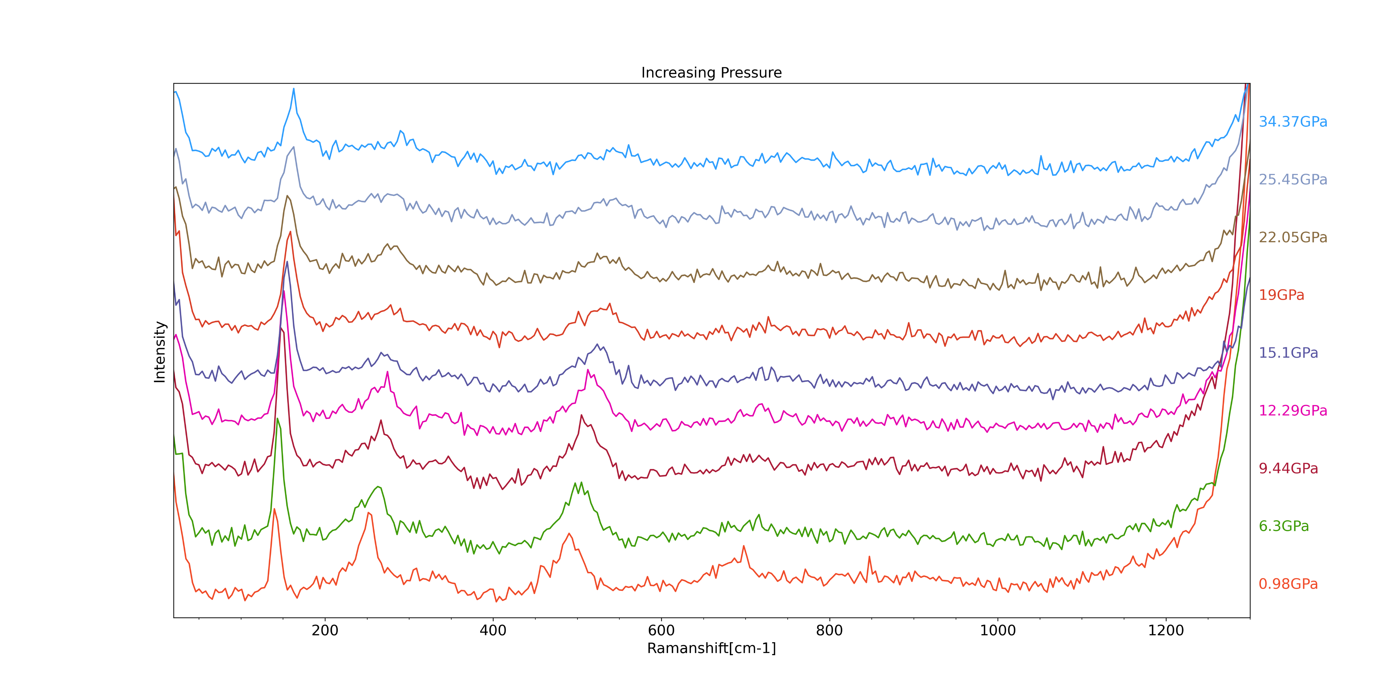
Raman Analysis for Mo2C

Slide 12
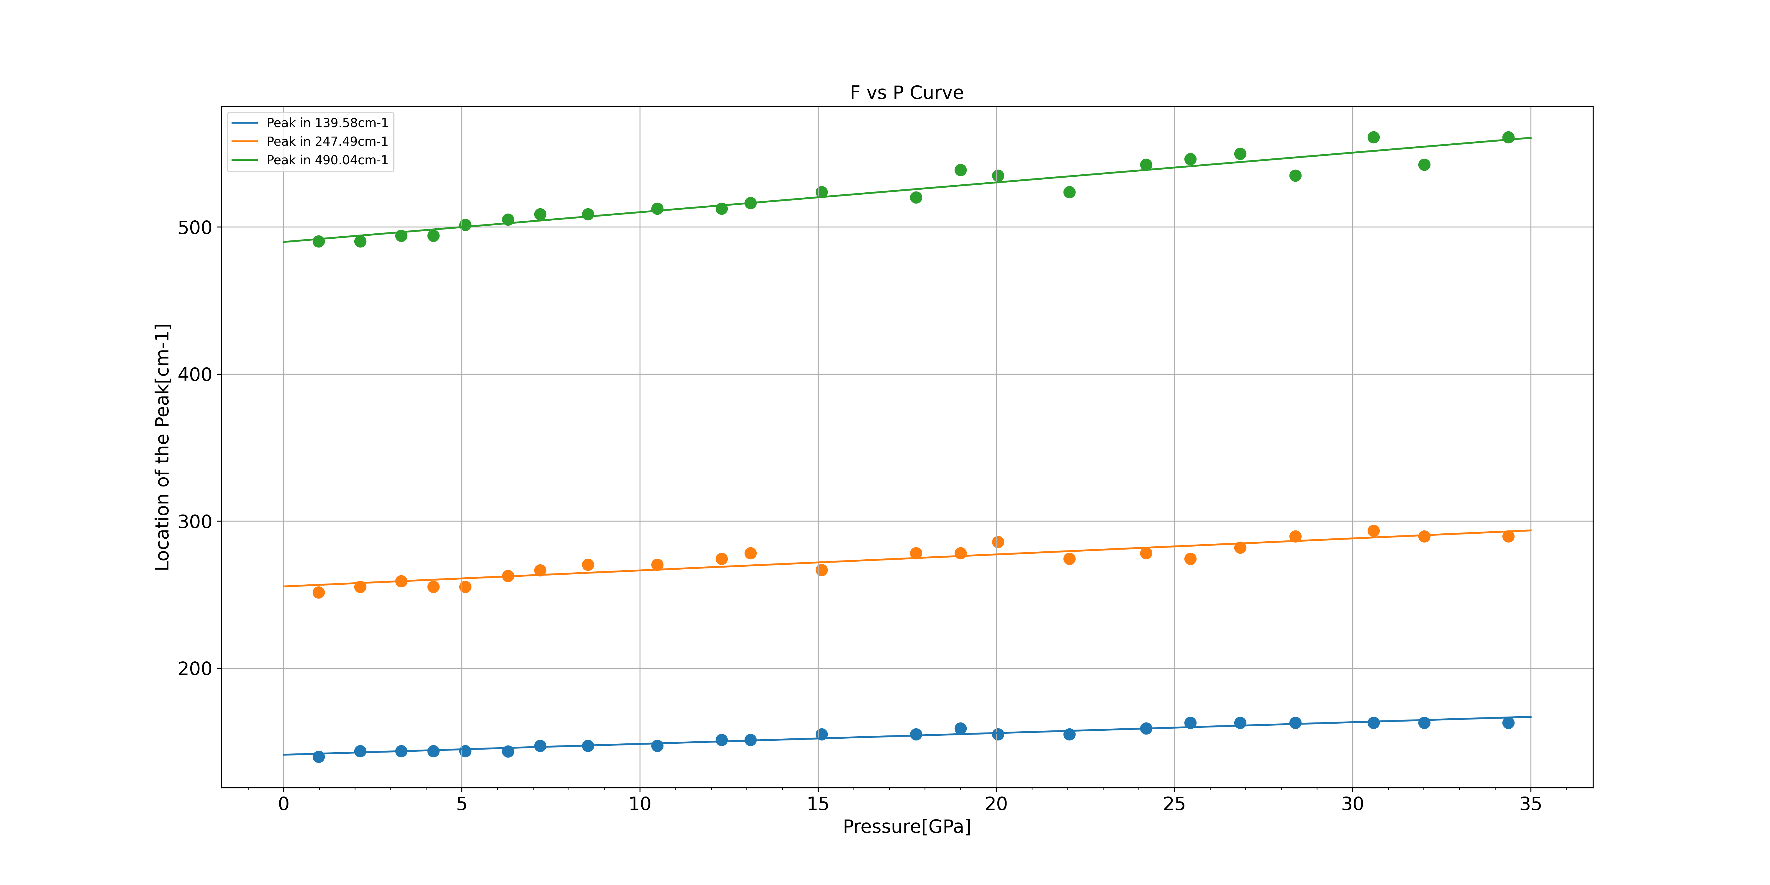
Raman Analysis for Mo2C
Top-down approach

Slide 13
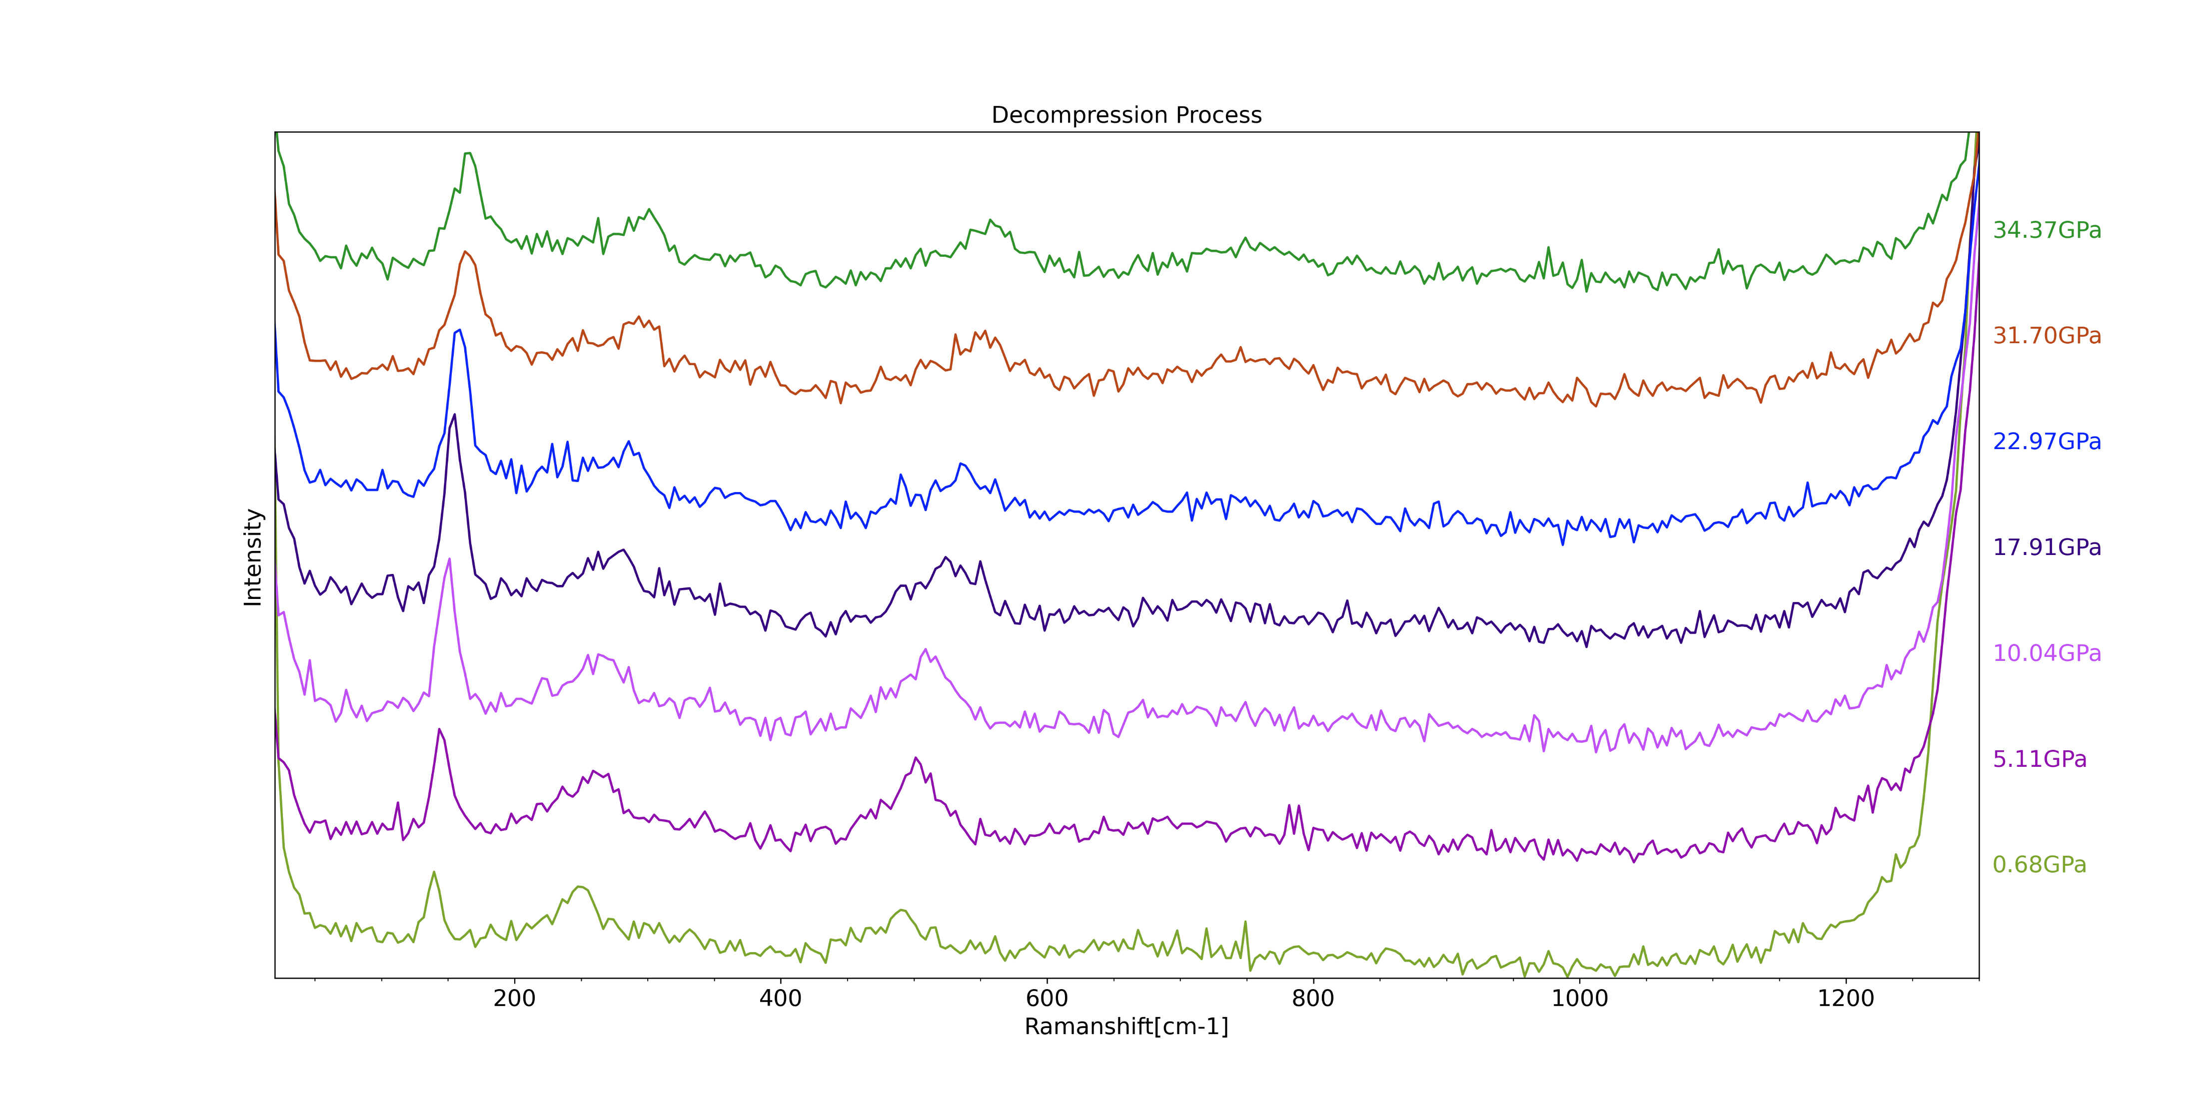
Raman Analysis for Mo2C
Top-down approach

Slide 14
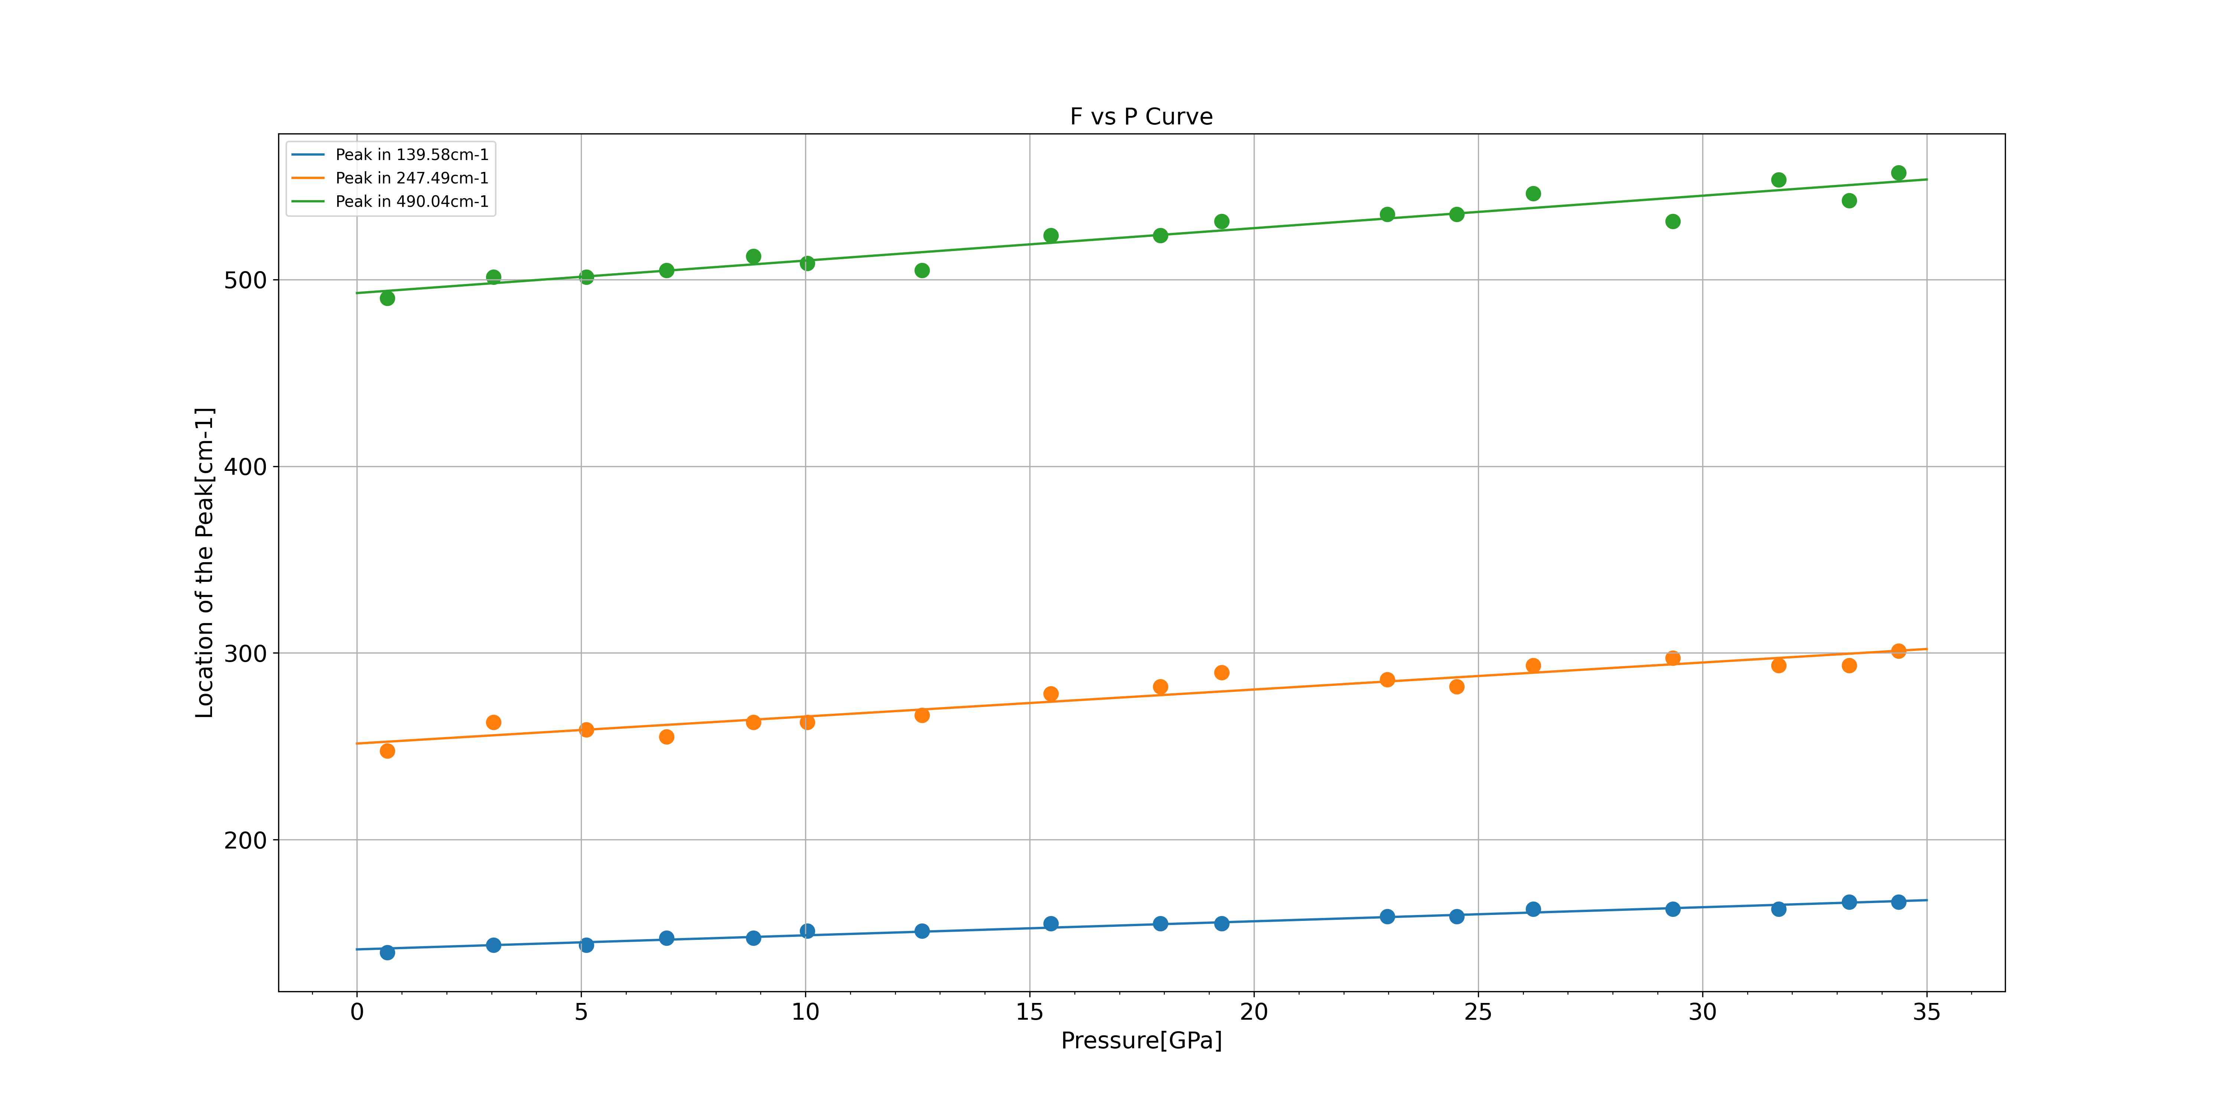
Raman Analysis for Mo2C
Top-down approach

Slide 15
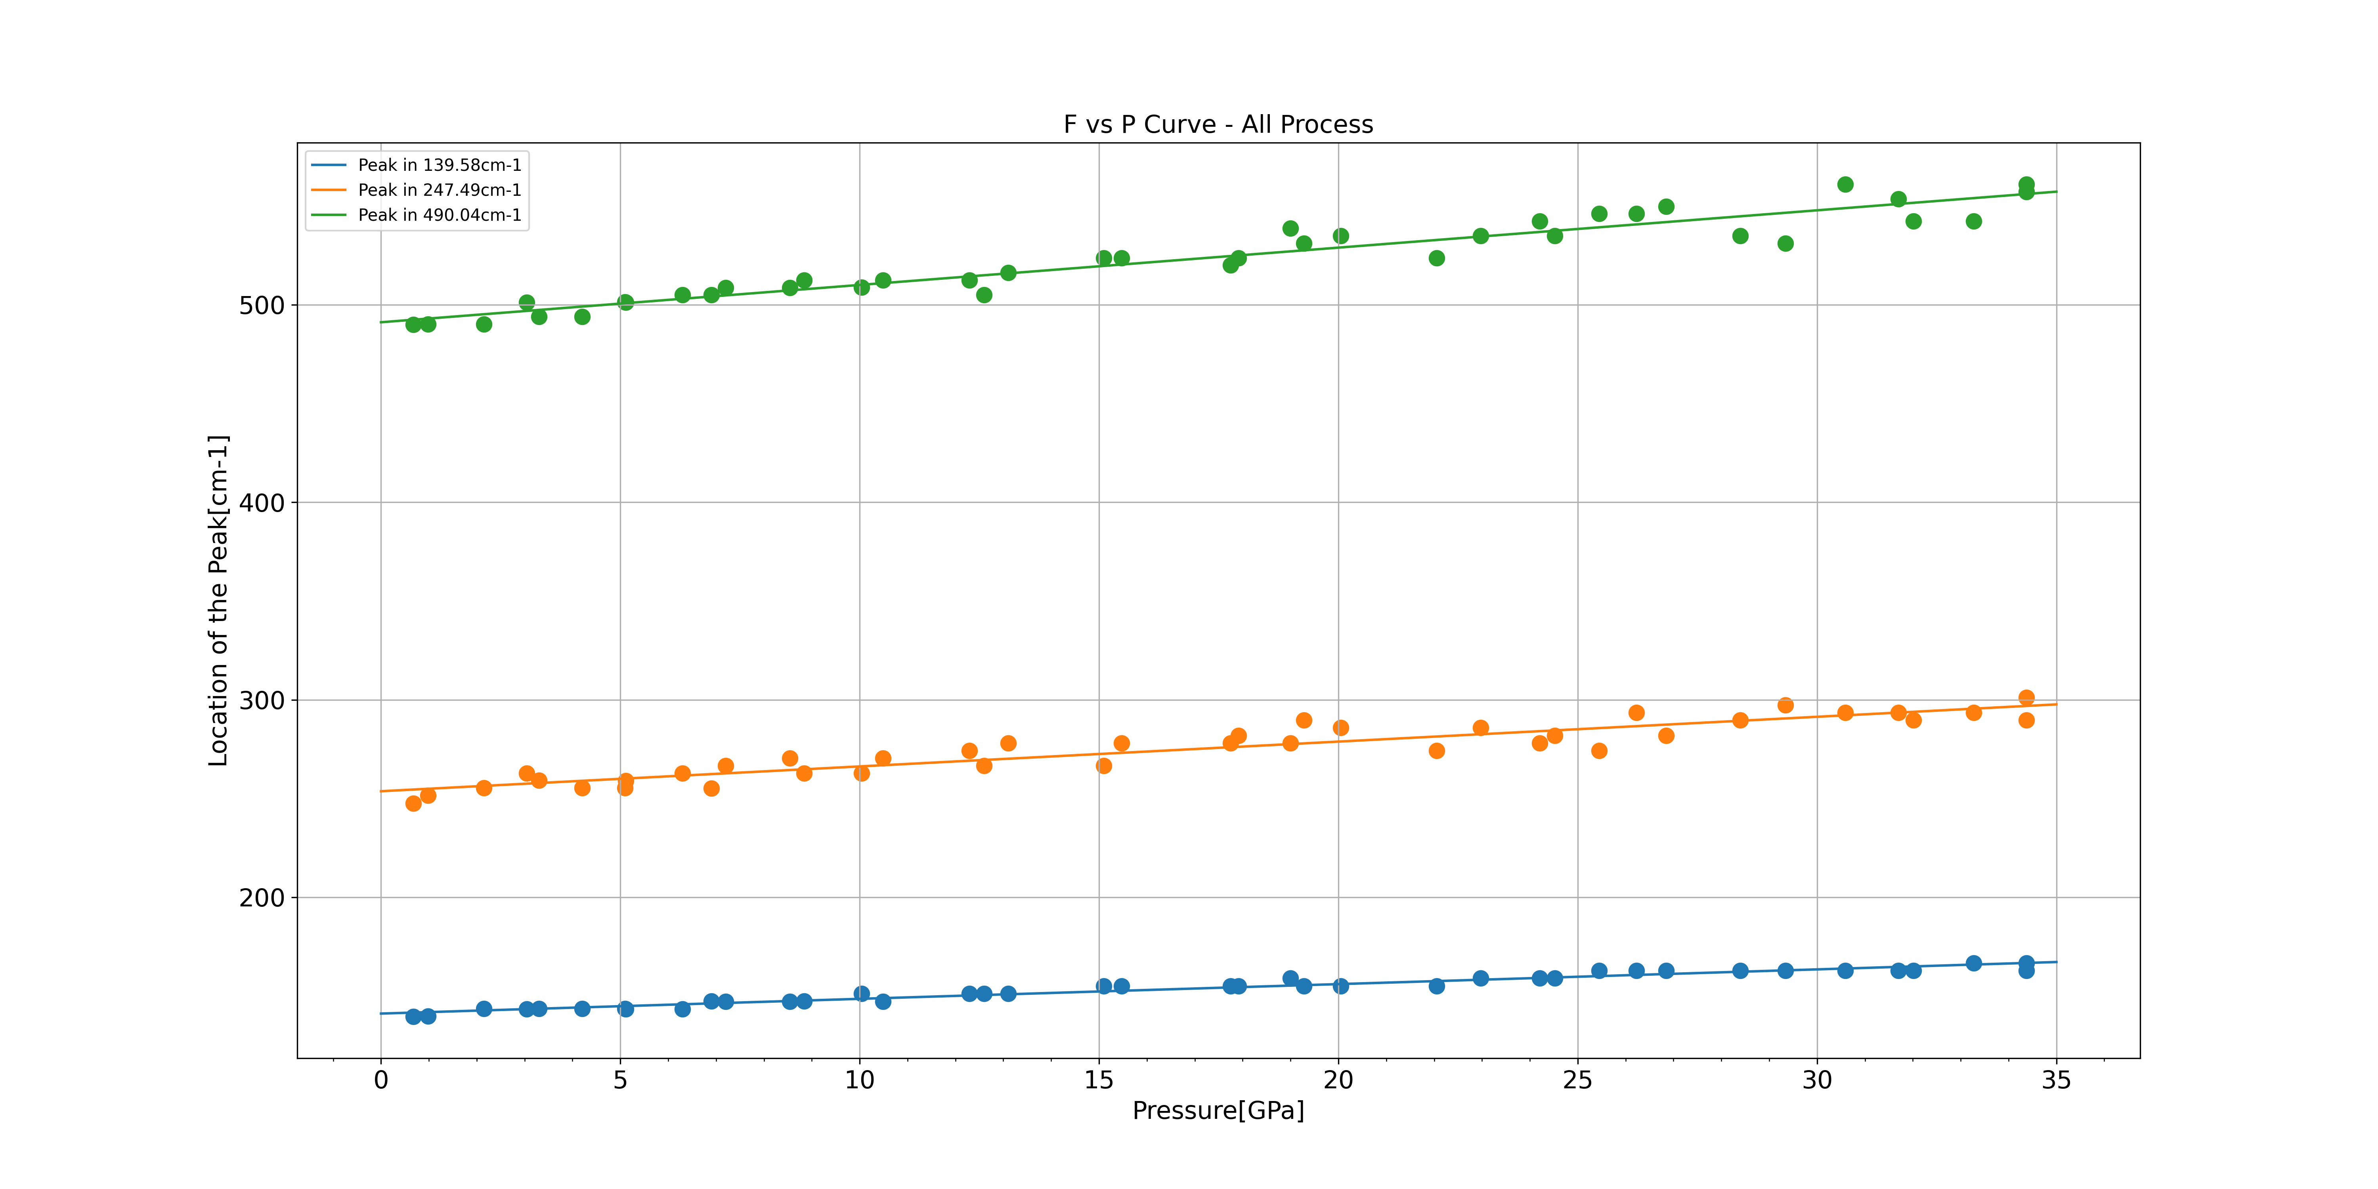
Raman Analysis for Mo2C
Top-down approach

Slide 16
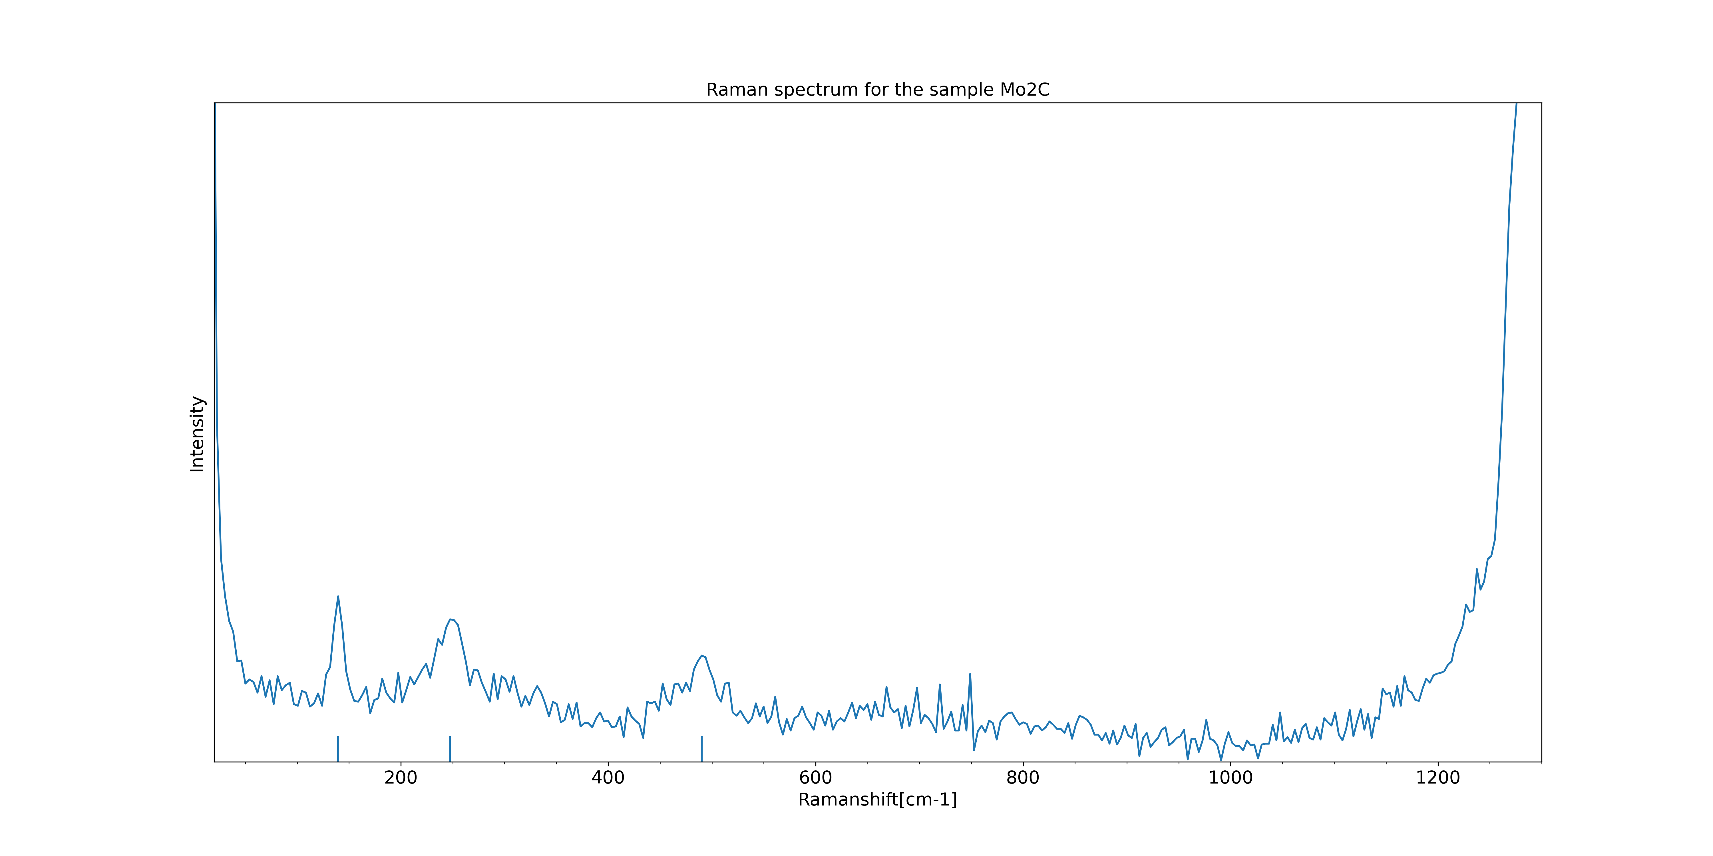
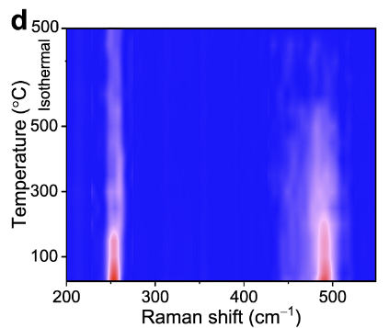
Raman Analysis for Mo2C
0.68GPa
Top-down approach
247.49
139.58
490.04
*Reference[4]: https://www.nature.com/articles/s41467-021-25784-0

Slide 17
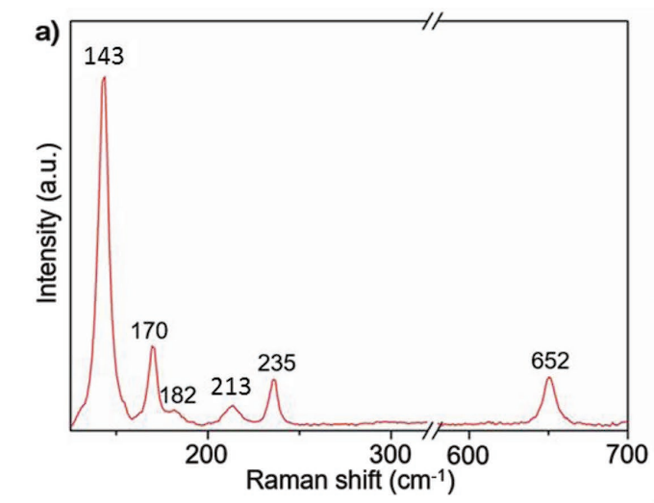
Raman Analysis for Mo2C
0.68GPa
Top-down approach
247.49
139.58
490.04
*Reference[5]: https://doi.org/10.1002/adma.201807160.

Slide 18
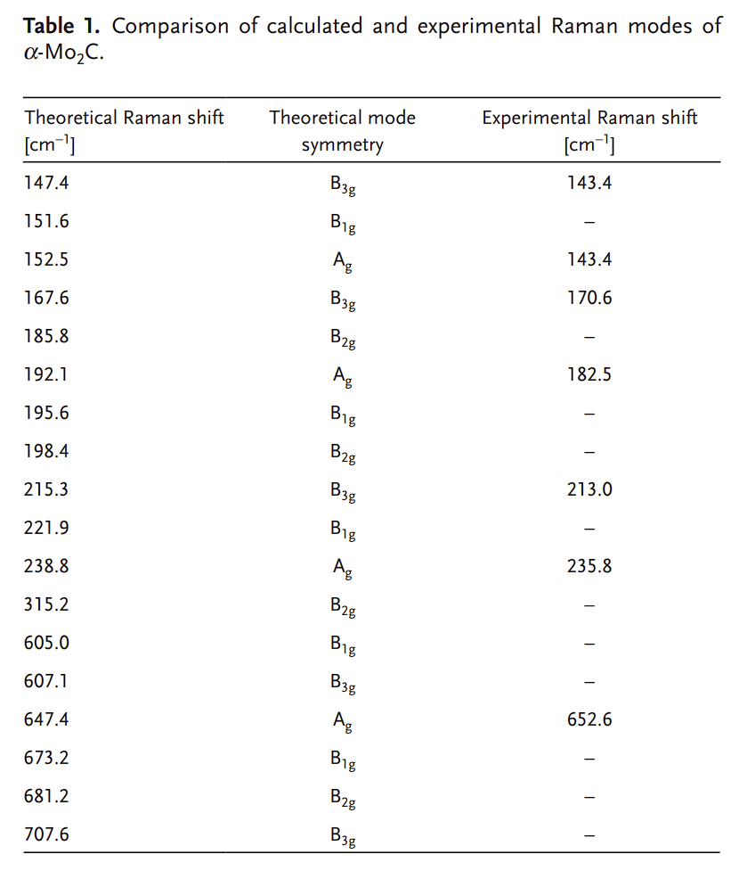
Raman Analysis for Mo2C
0.68GPa
139.58
247.49
490.04
*Reference[5]: https://doi.org/10.1002/adma.201807160.

Slide 19
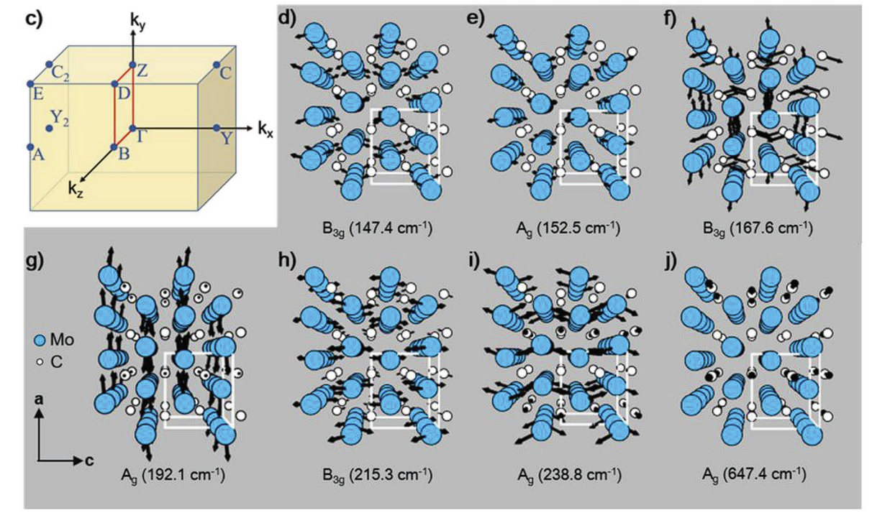
Raman Analysis for Mo2C
0.68GPa
139.58
247.49
*Reference[5]: https://doi.org/10.1002/adma.201807160.

Slide 20
SEM & EDS Analysis for UNKNOWN MATERIAL

Slide 21
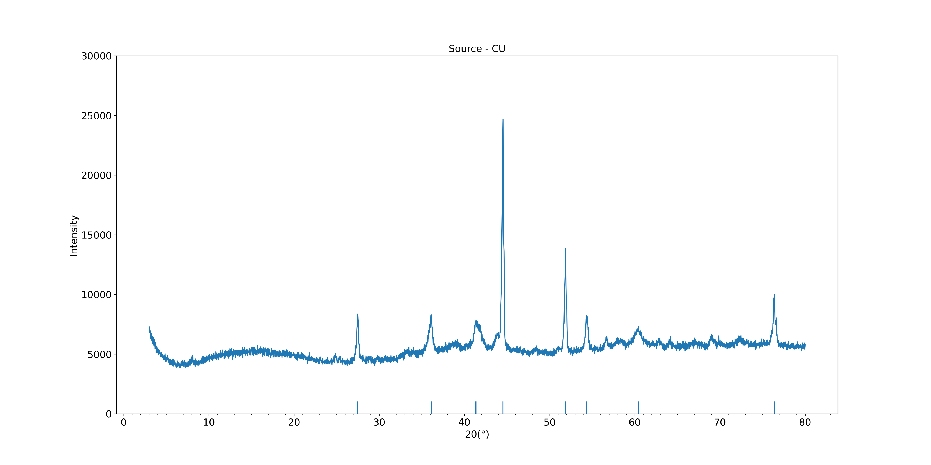
XRD Analysis for UNKNOWNMATERIAL
Top-down approach

Slide 22
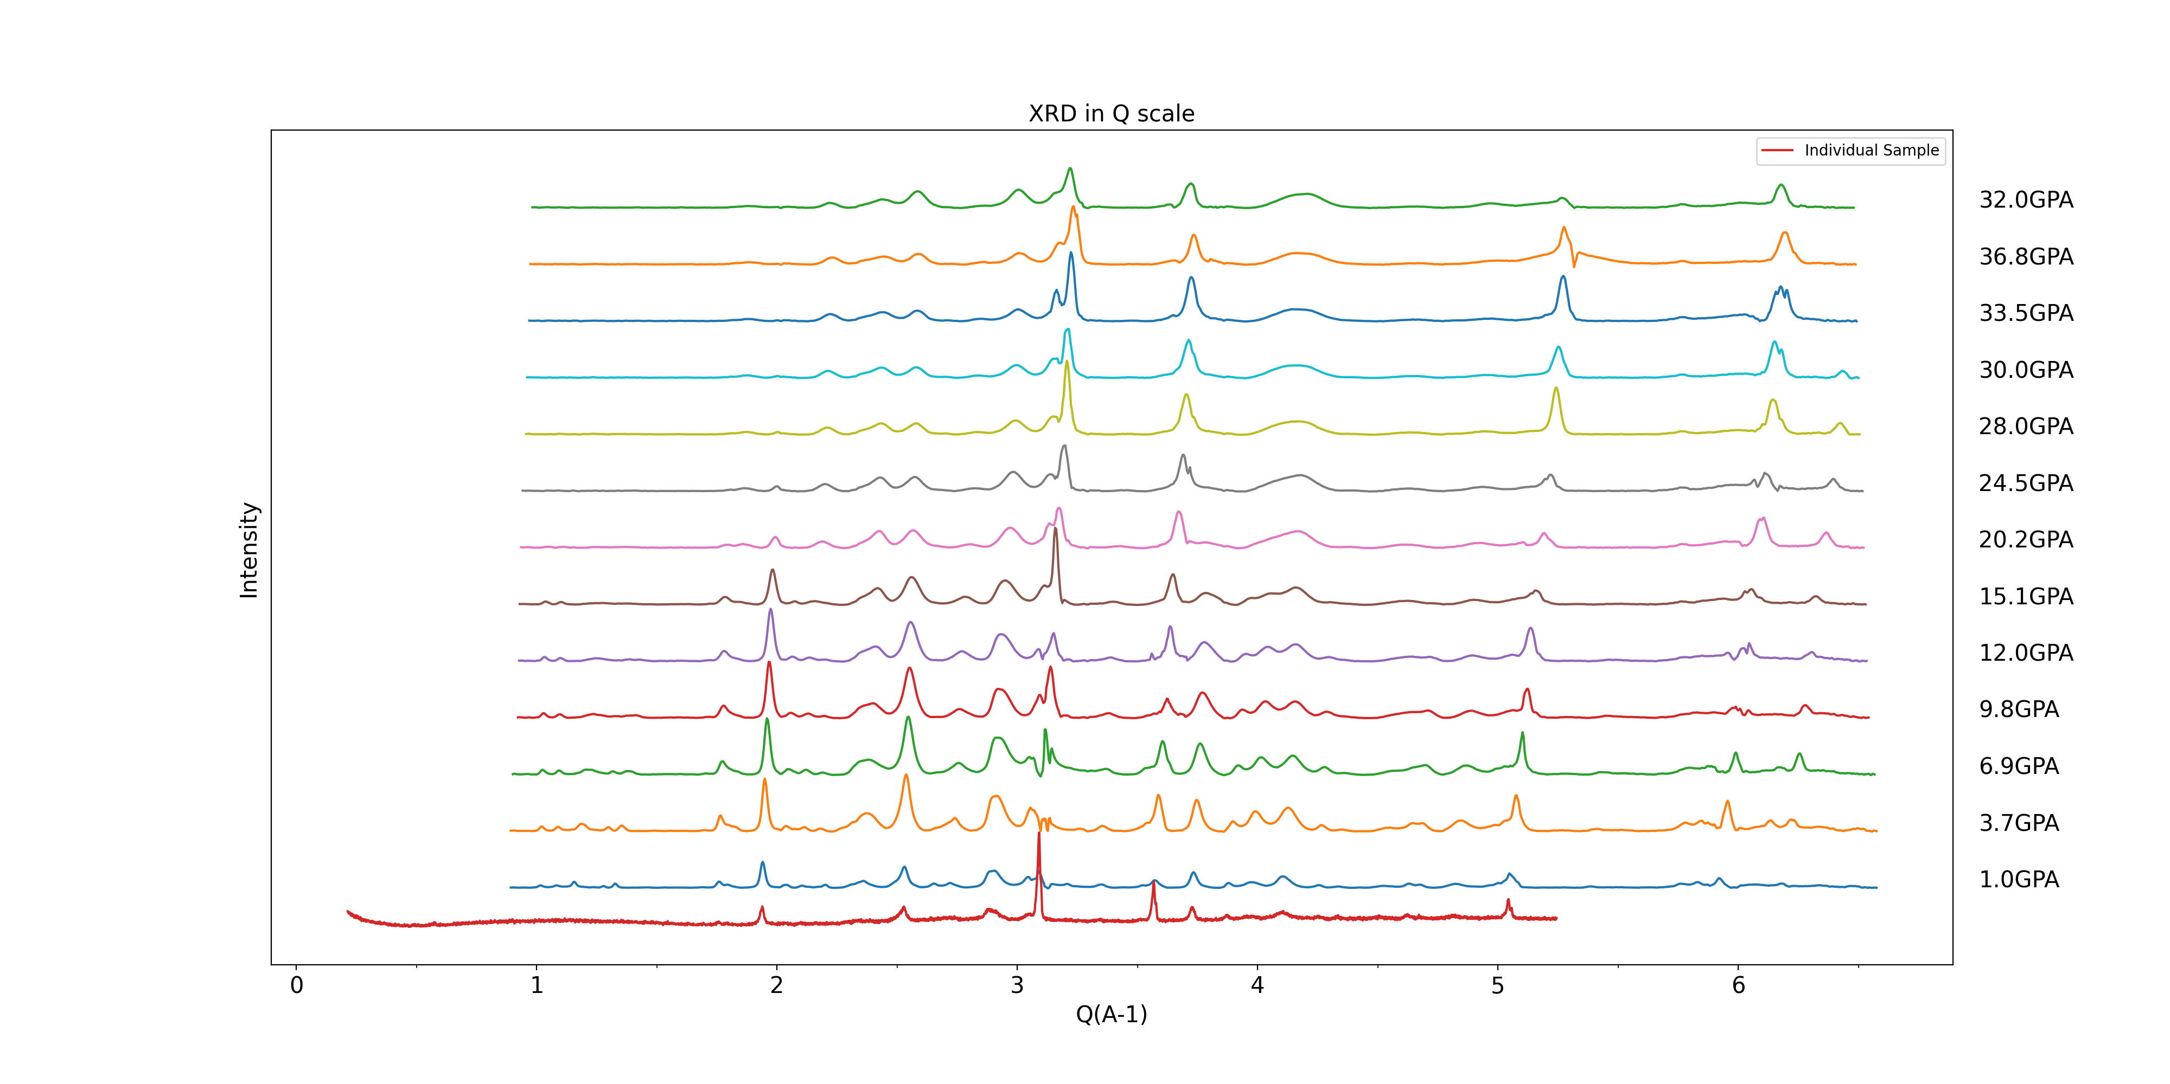
XRD Analysis for Mo2Ti2C3
Top-down approach

Slide 23
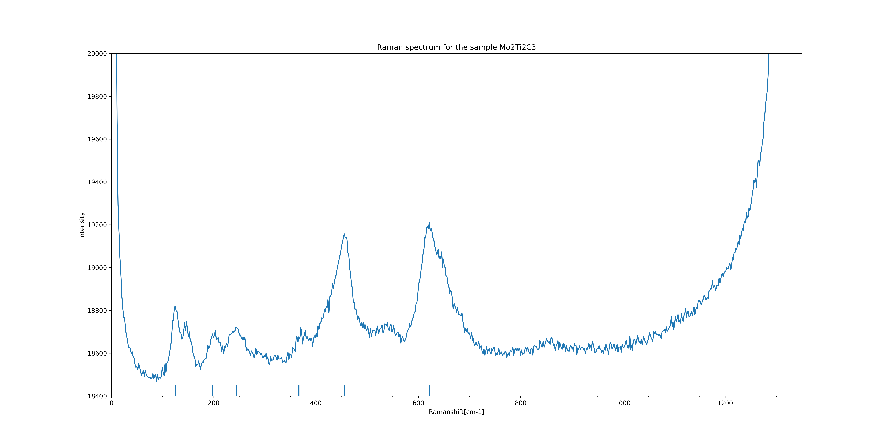
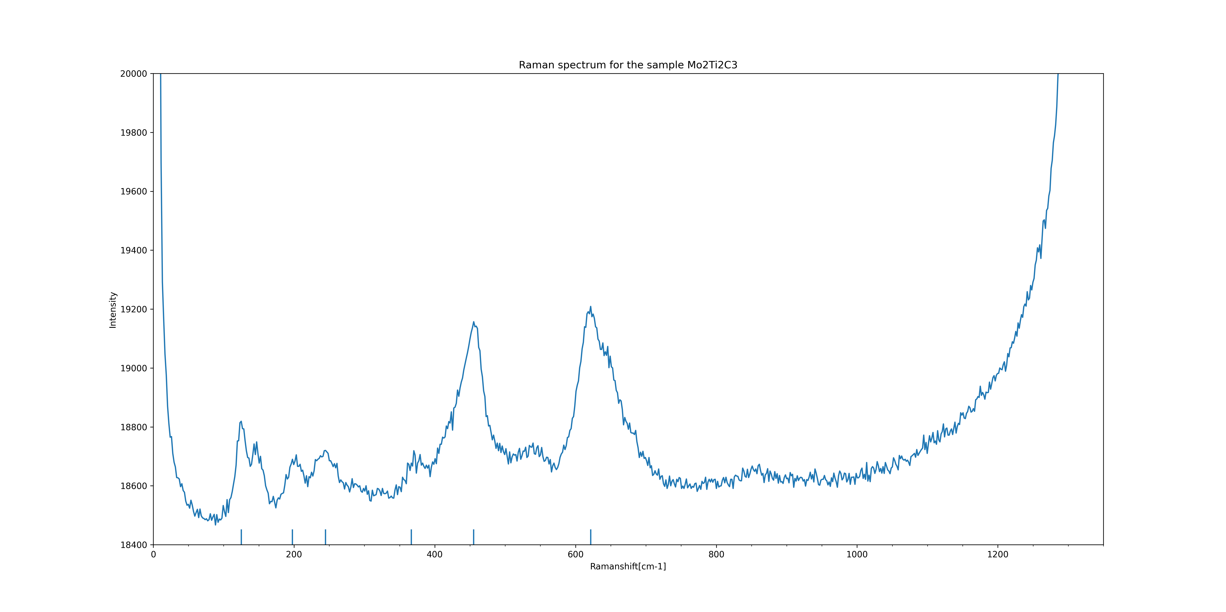
Raman Analysis for Mo2Ti2C3
4.05GPa
Top-down approach

Slide 24
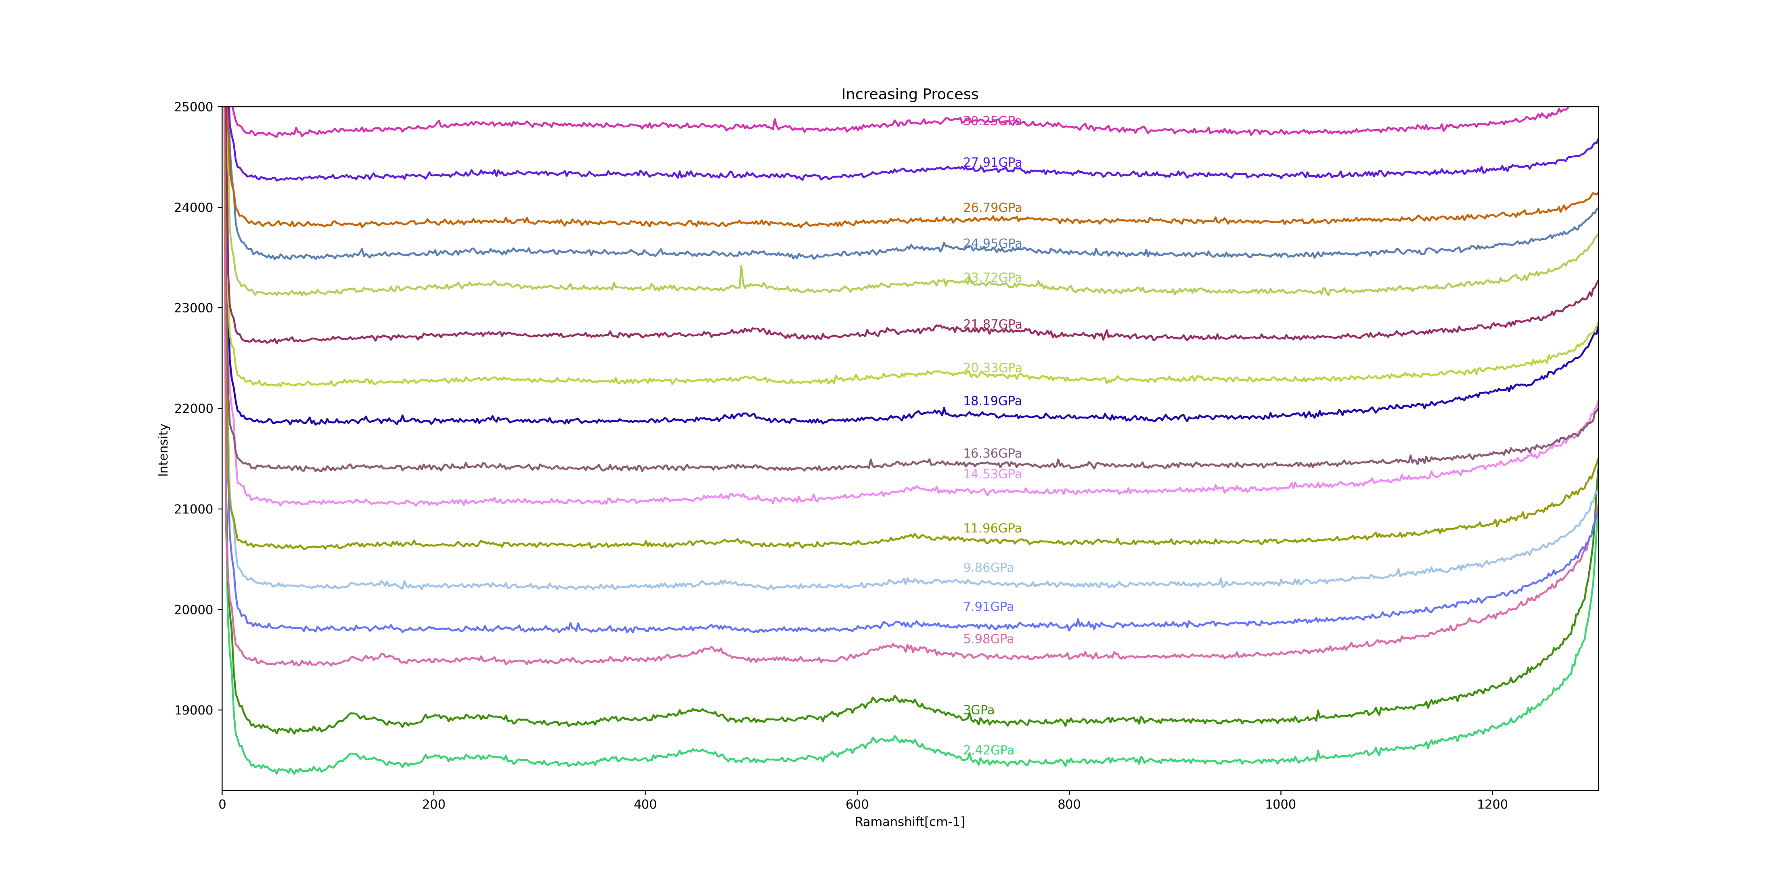
Raman Analysis for Mo2Ti2C3

Slide 25
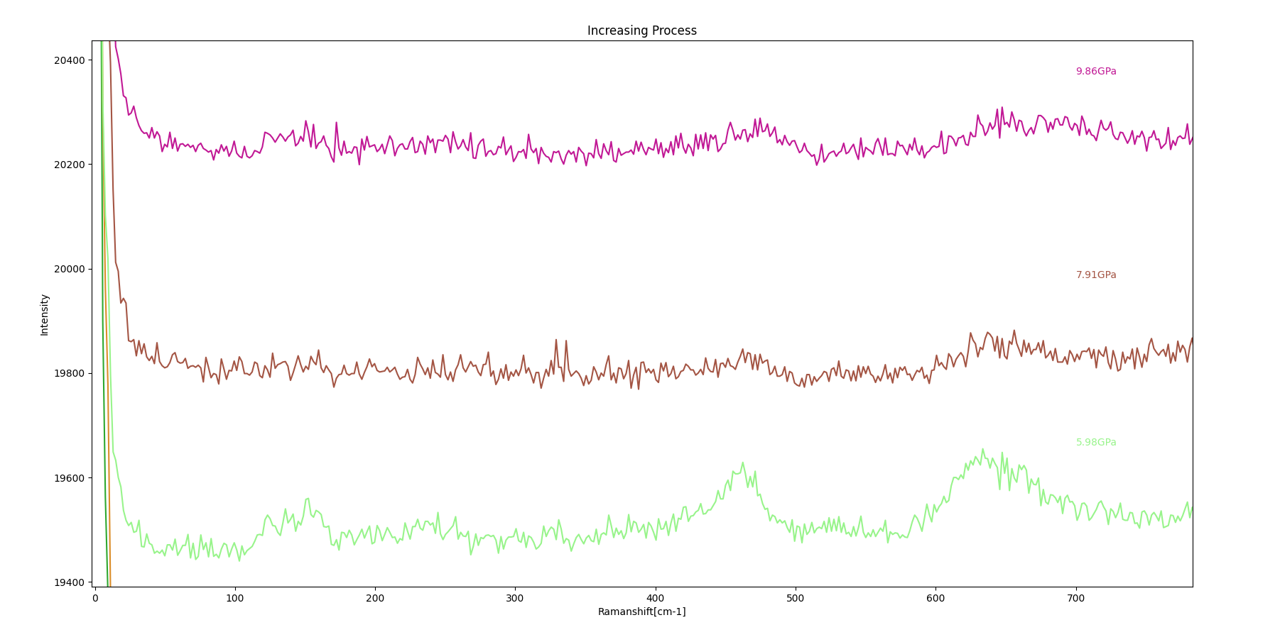
Raman Analysis for Mo2Ti2C3

Slide 26
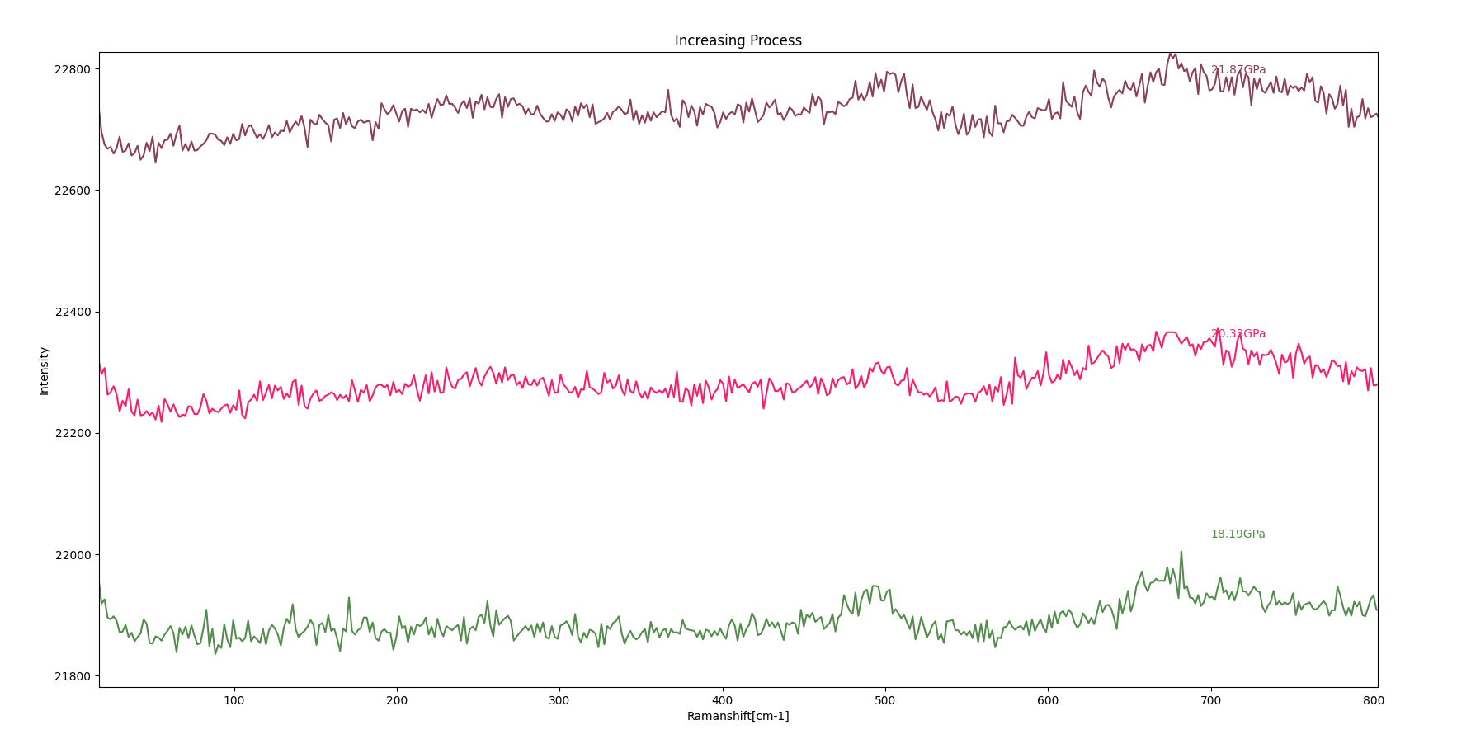
Raman Analysis for Mo2Ti2C3

Slide 27

The End
Team: YangBai, Zenan Wen
2023/6/xx

